Slide 1
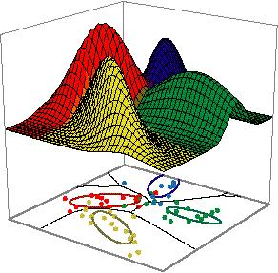
Week 12: Machine Learning
Supervised / Unsupervised Learning
Algorithms that learn to make predictions from examples (data)

Slide 2
What is Machine Learning?

Slide 3
ML: The study and design of intelligent agents
That make decisions based on data.

Slide 4
Machine Learning
Unsupervised Learning
Supervised Learning
Learning
Feature Learning
Reinforcement Learning

Slide 5

Deep Learning

Slide 6
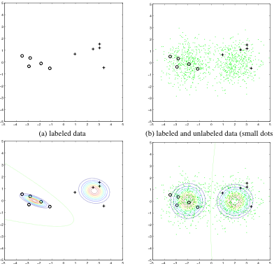
Types of Machine Learning
Supervised Learning
Labels are provided, there is a strong learning signal.
e.g. classification, regression.
Reinforcement learning.
The learning signal is a (scalar) reward and may come with a delay.
e.g. trying to learn to play chess, a mouse in a maze.
Unsupervised learning
There is no direct learning signal. We are simply trying to find structure in data.
e.g. clustering, dimensionality reduction.

Slide 7
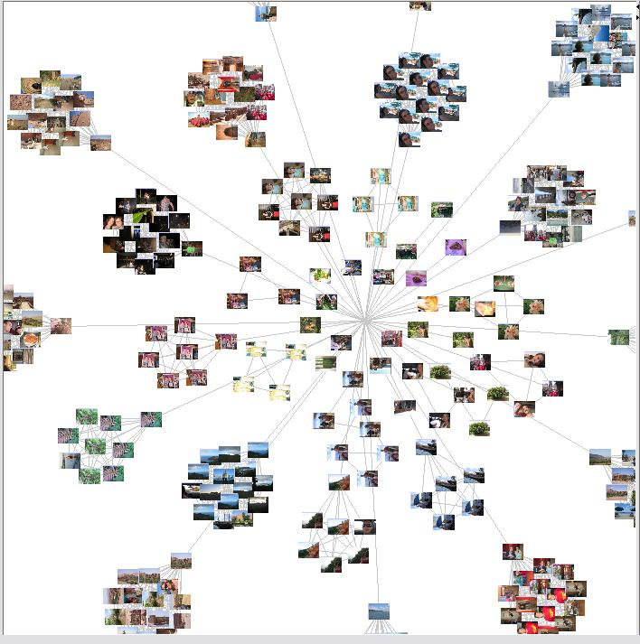
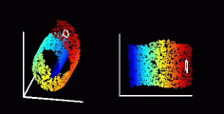
Unsupervised Learning:
Dimensionality Reduction:
clustering
(LLE – Roweis & Saul)

Slide 8

A gentle introduction to clustering

Slide 9
Clustering: Grouping together similar data-points

Slide 10
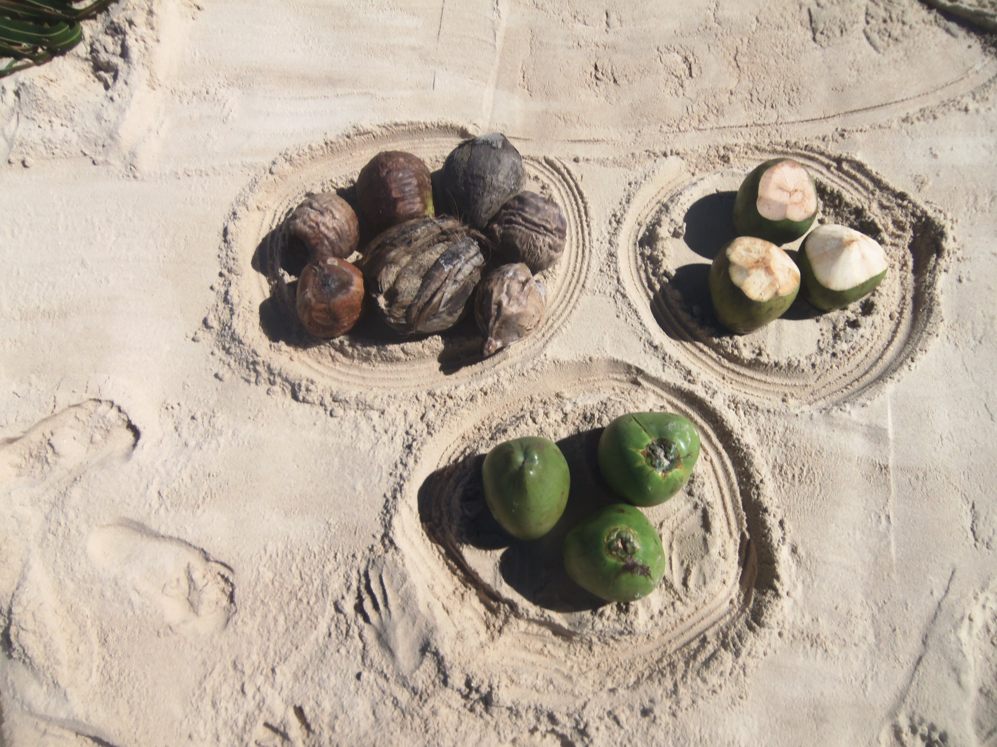
Clustering
Features are similar
Features are similar

Slide 11
Clustering 2D Data
Index | Feature 1 | Feature 2
0 | 50.3 | 8.5
1 | 12.1 | 86.4
2 | 8.6 | 76.6
3 | 69.8 | 6.5
4 | 99.1 | 10.2
5 | 10.1 | 87.6
6 | 8.4 | 64.5
7 | 6.5 | 75.4
8 | 83.5 | 8.4
9 | 92.1 | 2.1
10 | 6.6 | 75.5
11 | 6.7 | 92.4

Slide 12
Similarity is Euclidean
Index | Feature 1 | Feature 2
0 | 50.3 | 8.5
1 | 12.1 | 86.4
2 | 8.6 | 76.6
3 | 69.8 | 6.5
4 | 99.1 | 10.2
5 | 10.1 | 87.6
6 | 8.4 | 64.5
7 | 6.5 | 75.4
8 | 83.5 | 8.4
9 | 92.1 | 2.1
10 | 6.6 | 75.5
11 | 6.7 | 92.4
Not similar
Feature 2
Similar
Feature 1

Slide 26
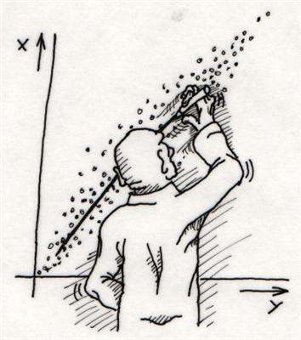
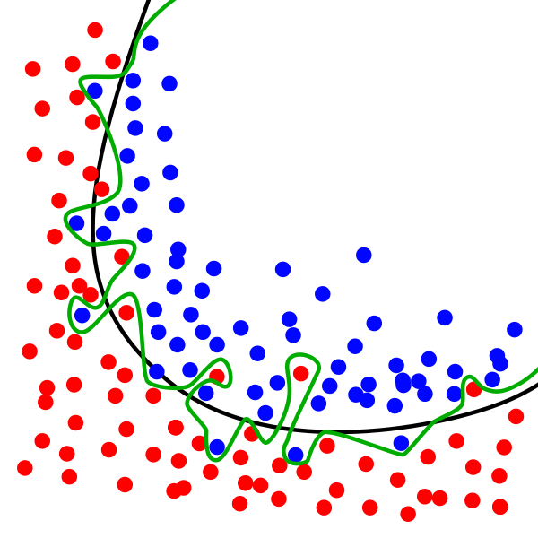
Supervised Learning
Regression
Classification

Slide 27
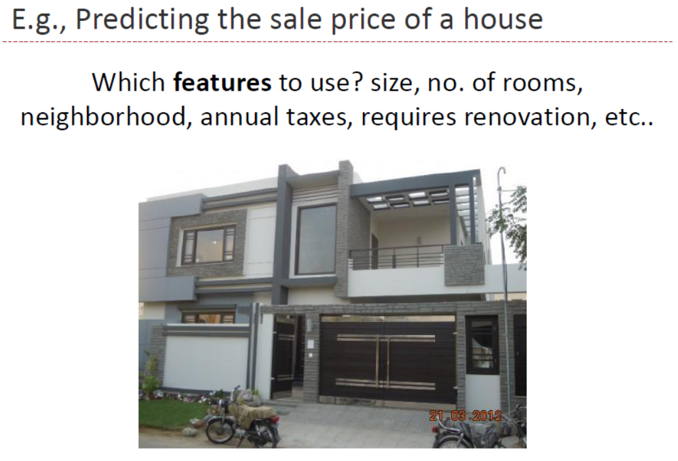

Slide 28
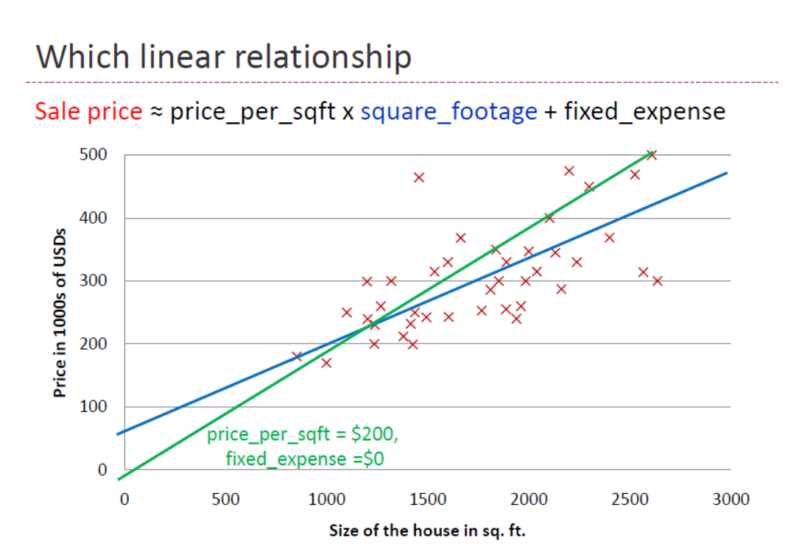

Slide 29
Housing Prices
(Portland, OR)
Price
(in 1000s of dollars)
Size (feet²)
Supervised Learning
Given the “right answer” for each example in the data.
Regression Problem
Predict real-valued output

Slide 30
Training Set
How do we represent h ?
Learning Algorithm
Size of house
h
Estimated price
Linear regression with one variable.
Univariate linear regression.

Slide 31
Overfitting and Underfitting
Y
X
Notes:
31

Slide 32
A Complex Model
Y = high-order polynomial in X
Y
X
Notes:
32

Slide 33
A Much Simpler Model
Y = m X + b + noise
Y
X
Notes:
33

Slide 34
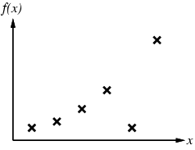
Example 2
Notes:
34

Slide 35
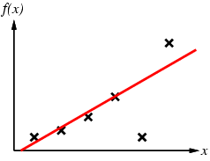
Example 2
Notes:
35

Slide 36
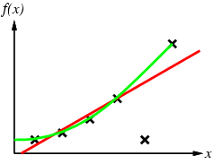
Example 2
Notes:
36

Slide 37
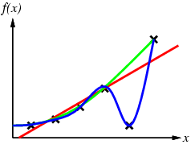
Example 2
Notes:
37

Slide 38
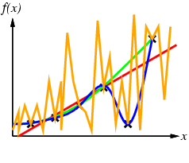
Example 2
Notes:
38

Slide 39
How Overfitting affects Prediction
Predictive
Error
Error on Training Data
Model Complexity
Notes:
39

Slide 40
How Overfitting affects Prediction
Predictive
Error
Error on Test Data
Error on Training Data
Model Complexity
Notes:
40

Slide 41
How Overfitting affects Prediction
Underfitting
Overfitting
Predictive
Error
Error on Test Data
Error on Training Data
Model Complexity
Ideal Range
for Model Complexity
Notes:
41

Slide 42
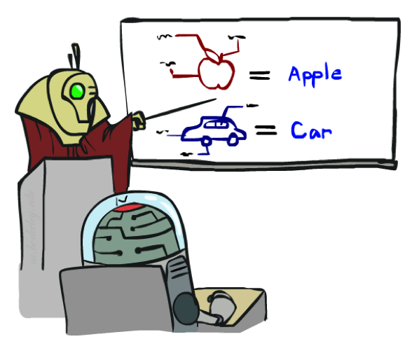


Training, Validation and Testing

Slide 43
Training and Validation Data
Full Data Set
Idea: train each
model on the
“training data”
and then test
each model’s
accuracy on
the validation data
Training Data
Validation Data
Notes:
43

Slide 44
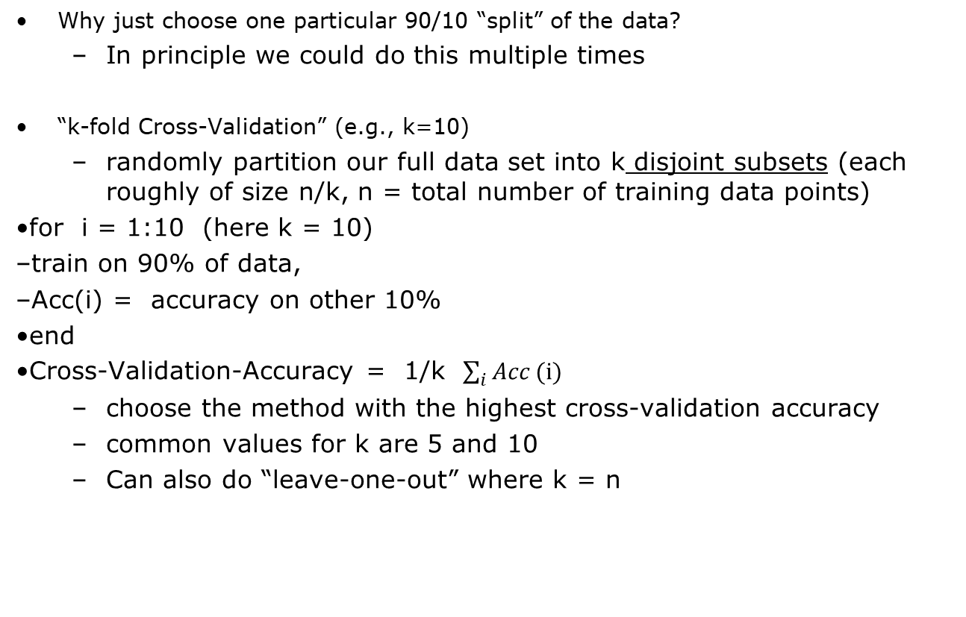
The k-fold Cross-Validation Method
Why just choose one particular 90/10 “split” of the data?
In principle we could do this multiple times
“k-fold Cross-Validation” (e.g., k=10)
randomly partition our full data set into k disjoint subsets (each roughly of size n/k, n = total number of training data points)
for i = 1:10 (here k = 10)
train on 90% of data,
Acc(i) = accuracy on other 10%
end
Cross-Validation-Accuracy = 1/k $\sum_{i}{Acc}(i)$
choose the method with the highest cross-validation accuracy
common values for k are 5 and 10
Can also do “leave-one-out” where k = n
Notes:
44

Slide 45
Disjoint Validation Data Sets
Validation Data (aka Test Data)
Full Data Set
1st partition
Training Data
Notes:
45

Slide 46
Disjoint Validation Data Sets
Validation Data (aka Test Data)
Full Data Set
1st partition
2nd partition
Training Data
Notes:
46

Slide 47
Disjoint Validation Data Sets
Validation Data (aka Test Data)
Full Data Set
Validation
Data
1st partition
2nd partition
Training Data
3rd partition
4th partition
5th partition
Notes:
47

Slide 48
More on Cross-Validation
Notes
cross-validation generates an approximate estimate of how well the learned model will do on “unseen” data
by averaging over different partitions it is more robust than just a single train/validate partition of the data
“k-fold” cross-validation is a generalization
partition data into disjoint validation subsets of size n/k
train, validate, and average over the v partitions
e.g., k=10 is commonly used
k-fold cross-validation is approximately k times computationally more expensive than just fitting a model to all of the data
Notes:
48

